Slide 1
Basic Computation
Chapter 2
Edited by JJ Shepherd

Slide 2
Objectives
Describe the Java data types used for simple data
Write Java statements to declare variables, define named constants
Write assignment statements, expressions containing variables and constants
Define strings of characters, perform simple string processing

Slide 3
Objectives
Write Java statements that accomplish keyboard input, screen output
Adhere to stylistic guidelines and conventions
Write meaningful comments

Slide 4
Outline
Variables and Expressions
The Class String
Keyboard and Screen I/O
Documentation and Style

Slide 5
Variables and Expressions: Outline
Variables
Data Types
Java Identifiers
Assignment Statements
Simple Input
Simple Screen Output
Constants
Named Constants

Slide 6
Variables and Expressions: Outline
Assignment Compatibilities
Type Casting
Arithmetic Operations
Parentheses and Precedence Rules
Specialized Assignment Operators
Case Study: Vending Machine Change
Increment and Decrement Operators

Slide 7

Variables
Variables store data such as numbers and letters.
  Think of them as places to store data.
  They are implemented as memory locations.
int numberOfCats = 1;

Slide 8
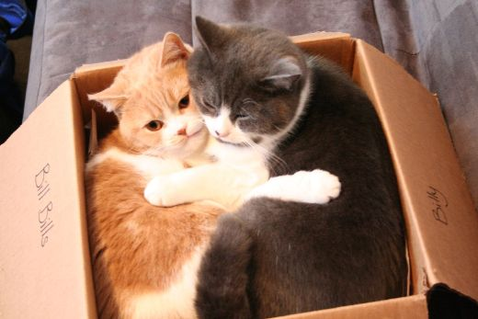
Variables
The data stored by a variable is called its value.
  The value is stored in the memory location.
Its value can be changed.
int numberOfCats = 2;

Slide 9
Naming and Declaring Variables
Choose names that are helpful such as count or speed, but not c or s.
When you declare a variable, you provide its name and type.
int numberOfBaskets,eggsPerBasket;
A variable's type determines what kinds of values it can hold (int, double, char, etc.).
A variable must be declared before it is used.

Slide 10
Syntax and Examples
Syntax
  type variable_1, variable_2, …;
  (variable_1 is a generic variable called a syntactic variable)
Examples
  int styleChoice, numberOfChecks;
  double balance, interestRate;
  char jointOrIndividual;

Slide 11
THE BIG IDEA
To declare variables you provide its TYPE and NAME
Let’s look at these in more detail starting with…
int numberOfCats;
Type
Name

Slide 12
TYPES

Slide 13
Data Types
A class type is used for a class of objects and has both data and methods.
  "Java is fun" is a value of class type String
A primitive type is used for simple, nondecomposable values such as an individual number or individual character.
  int, double, and char are primitive types.

Slide 14
Primitive Types
Four integer types (byte, short, int, and long)
  int is most common
Two floating-point types (float and double)
  double is more common
One character type (char)
One boolean type (boolean)

Slide 15
Examples of Primitive Values
Integer types
0 -1 365 12000
Floating-point types
0.99 -22.8 3.14159 5.0
Character type
'a' 'A' '#' ' '
Boolean type
true false

Slide 16
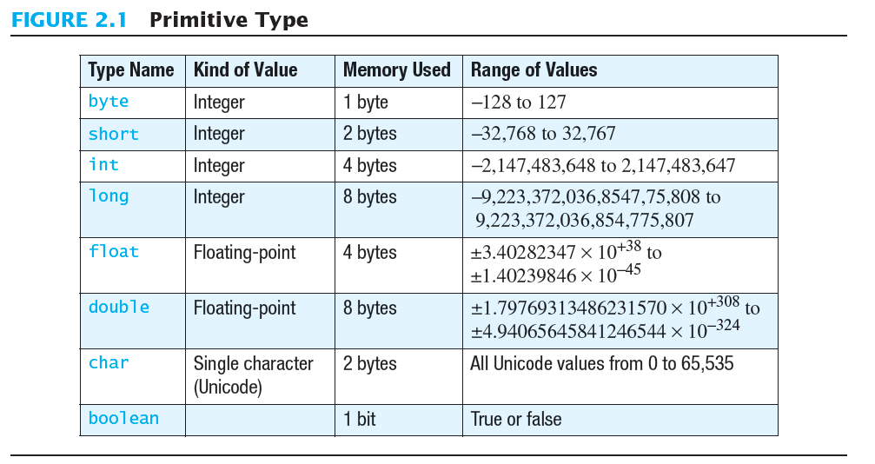
Primitive Types
You’ll use these most often

Slide 17
NAMES

Slide 18
Java Identifiers
An identifier is a name, such as the name of a variable.
Identifiers may contain only
  Letters
  Digits (0 through 9)
  The underscore character (_)
  And the dollar sign symbol ($) which has a special meaning
The first character cannot be a digit.

Slide 19
Java Identifiers
Identifiers may not contain any spaces, dots (.), asterisks (*), or other characters:
7-11 oracle.com util.* (not allowed)
Identifiers can be arbitrarily long.
Since Java is case sensitive, stuff, Stuff, and STUFF are different identifiers.

Slide 20
Keywords or Reserved Words
Words such as if are called keywords or reserved words and have special, predefined meanings.
  Cannot be used as identifiers.
  See Appendix 1 for a complete list of Java keywords.
Example keywords: int, public, class

Slide 21

SYNTAX ERROR!
int class;

Slide 22
Naming Conventions
Class types begin with an uppercase letter
(e.g. String).
Primitive types begin with a lowercase letter (e.g. int).
Variables of both class and primitive types begin with a lowercase letters
(e.g. myName, myBalance).
Multiword names are "punctuated" using uppercase letters.

Slide 23

Naming Conventions
The method for lower casing the first letter in the name and then uppercasing the first letter in each word is sometimes called “Camel Casing”

Slide 24
Where to Declare Variables
Declare a variable
  Just before it is used or
  At the beginning of the section of your program that is enclosed in {}.
  public static void main(String[] args)
  { /* declare variables here */
  . . .
  }

Slide 25
Assignment Statements
An assignment statement is used to assign a value to a variable.
  answer = 42;
The "equal sign" is called the assignment operator.
We say, "The variable named answer is assigned a value of 42," or more simply, "answer is assigned 42."

Slide 26
Assignment Statements
Syntax
variable = expression
where expression can be another variable, a literal or constant (such as a number), or something more complicated which combines variables and literals using operators
(such as + and -)

Slide 27
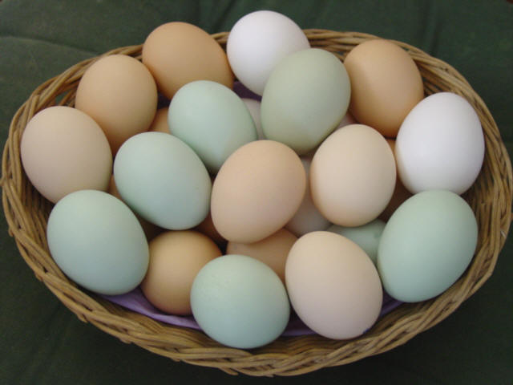
Assignment Examples
amount = 3.99;
firstInitial = 'W';
score = numberOfCards + handicap;
eggsPerBasket = eggsPerBasket - 2;

Slide 28
Initializing Variables
A variable that has been declared, but no yet given a value is said to be uninitialized.
Uninitialized class variables have the value null.
Uninitialized primitive variables may have a default value.
***It's good practice not to rely on a default value.***

Slide 29
Initializing Variables
To protect against an uninitialized variable (and to keep the compiler happy), assign a value at the time the variable is declared.
Examples:
int count = 0;
char grade = 'A';

Slide 30

Initializing Variables
syntax
type variable_1 = expression_1, variable_2 = expression_2, …;
int powerLevel = 9001;

Slide 31
Assignment Evaluation
The expression on the right-hand side of the assignment operator (=) is evaluated first.
The result is used to set the value of the variable on the left-hand side of the assignment operator.
score = numberOfCards + handicap;
eggsPerBasket = eggsPerBasket - 2;

Slide 32
INPUT
OUTPUT

Slide 33
Simple Input
Sometimes the data needed for a computation are obtained from the user at run time.
Keyboard input requires
import java.util.Scanner
at the beginning of the file.

Slide 34
Simple Input
Data can be entered from the keyboard using Scanner keyboard =
new Scanner(System.in);
followed, for example, by
eggsPerBasket = keyboard.nextInt();
which reads one int value from the keyboard and assigns it to eggsPerBasket.

Slide 35
Simple Screen Output
System.out.println("The count is " + count);
Outputs the sting literal "the count is "
Followed by the current value of the variable count.

Slide 36
MORE STUFF!

Slide 37
Constants
Literal expressions such as 2, 3.7, or 'y' are called constants.
Integer constants can be preceded by a + or - sign, but cannot contain commas.
Floating-point constants can be written
  With digits after a decimal point or
  Using e notation.

Slide 38
Named Constants
Java provides mechanism to …
  Define a variable
  Initialize it
  Fix the value so it cannot be changed
public static final Type Variable = Constant;
  Example
public static final double PI = 3.14159;

Slide 39
e Notation
e notation is also called scientific notation or floating-point notation.
Examples
  865000000.0 can be written as 8.65e8
  0.000483 can be written as 4.83e-4
The number in front of the e does not need to contain a decimal point.

Slide 40
Imprecision in Floating-Point Numbers
Floating-point numbers often are only approximations since they are stored with a finite number of bits.
Hence 1.0/3.0 is slightly less than 1/3.
1.0/3.0 + 1.0/3.0 + 1.0/3.0
is less than 1.

Slide 41
Assignment Compatibilities
Java is said to be strongly typed.
  You can't, for example, assign a floating point value to a variable declared to store an integer.
Sometimes conversions between numbers are possible.
doubleVariable = 7;
is possible even if doubleVariable is of type double, for example.

Slide 42
Assignment Compatibilities
A value of one type can be assigned to a variable of any type further to the right
byte --> short --> int --> long
--> float --> double
  But not to a variable of any type further to the left.
You can assign a value of type char to a variable of type int.

Slide 43
Type Casting
A type cast temporarily changes the value of a variable from the declared type to some other type.
For example,
double distance;
distance = 9.0;
int points;
points = (int)distance;
Illegal without (int)

Slide 44
Type Casting
The value of (int)distance is 9,
The value of distance, both before and after the cast, is 9.0.
Any nonzero value to the right of the decimal point is truncated rather than rounded.

Slide 45
MATH !!!!1!1!!

Slide 46
Arithmetic Operators
Arithmetic expressions can be formed using the +, -, *, and / operators together with variables or numbers referred to as operands.
  When both operands are of the same type, the result is of that type.
  When one of the operands is a floating-point type and the other is an integer, the result is a floating point type.

Slide 47
Arithmetic Operations
Example
If hoursWorked is an int to which the value 40 has been assigned, and payRate is a double to which 8.25 has been assigned
hoursWorked * payRate
is a double with a value of 500.0.

Slide 48
Arithmetic Operations
Expressions with two or more operators can be viewed as a series of steps, each involving only two operands.
  The result of one step produces one of the operands to be used in the next step.
example
  balance + (balance * rate)

Slide 49
Arithmetic Operations
If at least one of the operands is a floating-point type and the rest are integers, the result will be a floating point type.
The result is the rightmost type from the following list that occurs in the expression.
byte --> short --> int --> long
--> float --> double

Slide 50
The Division Operator
The division operator (/) behaves as expected if one of the operands is a floating-point type.
When both operands are integer types, the result is truncated, not rounded.
  Hence, 99/100 has a value of 0.

Slide 51
The mod Operator
The mod (%) operator is used with operators of integer type to obtain the remainder after integer division.
14 divided by 4 is 3 with a remainder of 2.
  Hence, 14 % 4 is equal to 2.
The mod operator has many uses, including
  determining if an integer is odd or even
  determining if one integer is evenly divisible by another integer.

